Slide 1
Content Page
1
Seriousness of aging problems in Singapore & and Implications
2
Policies in place
3
Compare internationally
& recommend policies

Slide 2
Seriousness of problem
1
Ageing population trend
Implication to housing sector
Notes:
1. Is ageing population a problem in Singapore? How serious is the problem? What are the implications to housing sectors? (20 marks)

Slide 3
Ageing Population Trend
Increasing rate of ageing
Pension problem
Low income
Shortage in supply & lack of housing options for single elderly rly

Slide 4
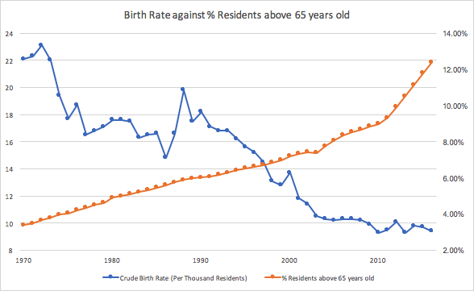
1.Increasing rate of ageing - Adverse impact on old-age dependency and potential support
 | 1970 | 2016
Median age | 19.5 | 40.0
Life expectancy | 65.8 | 82.9
Old age support ratio | 13.5 | 5.4
Source: Singstat, 2016
2016
Notes:
http://www.tablebuilder.singstat.gov.sg/publicfacing/createDataTable.action?refId=3733
http://www.tablebuilder.singstat.gov.sg/publicfacing/mainMenu.action
http://www.singstat.gov.sg/docs/default-source/default-document-library/publications/publications_and_papers/reference/yearbook_2017/yos2017.pdf

Slide 5
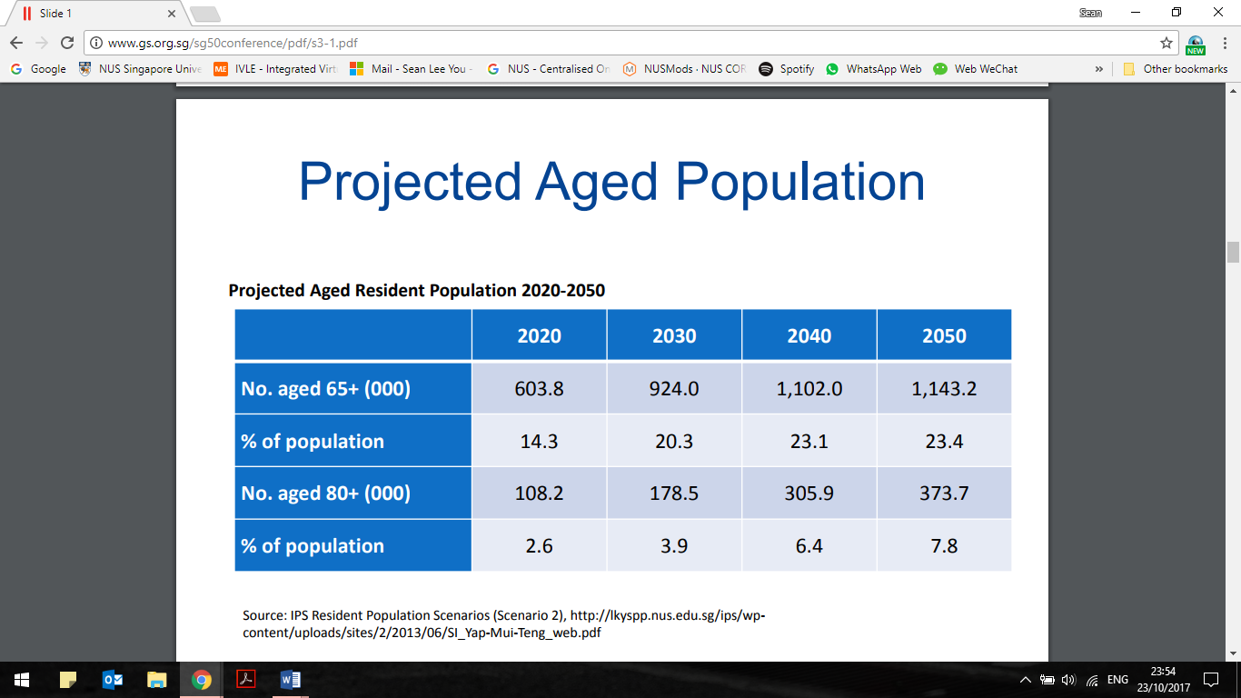
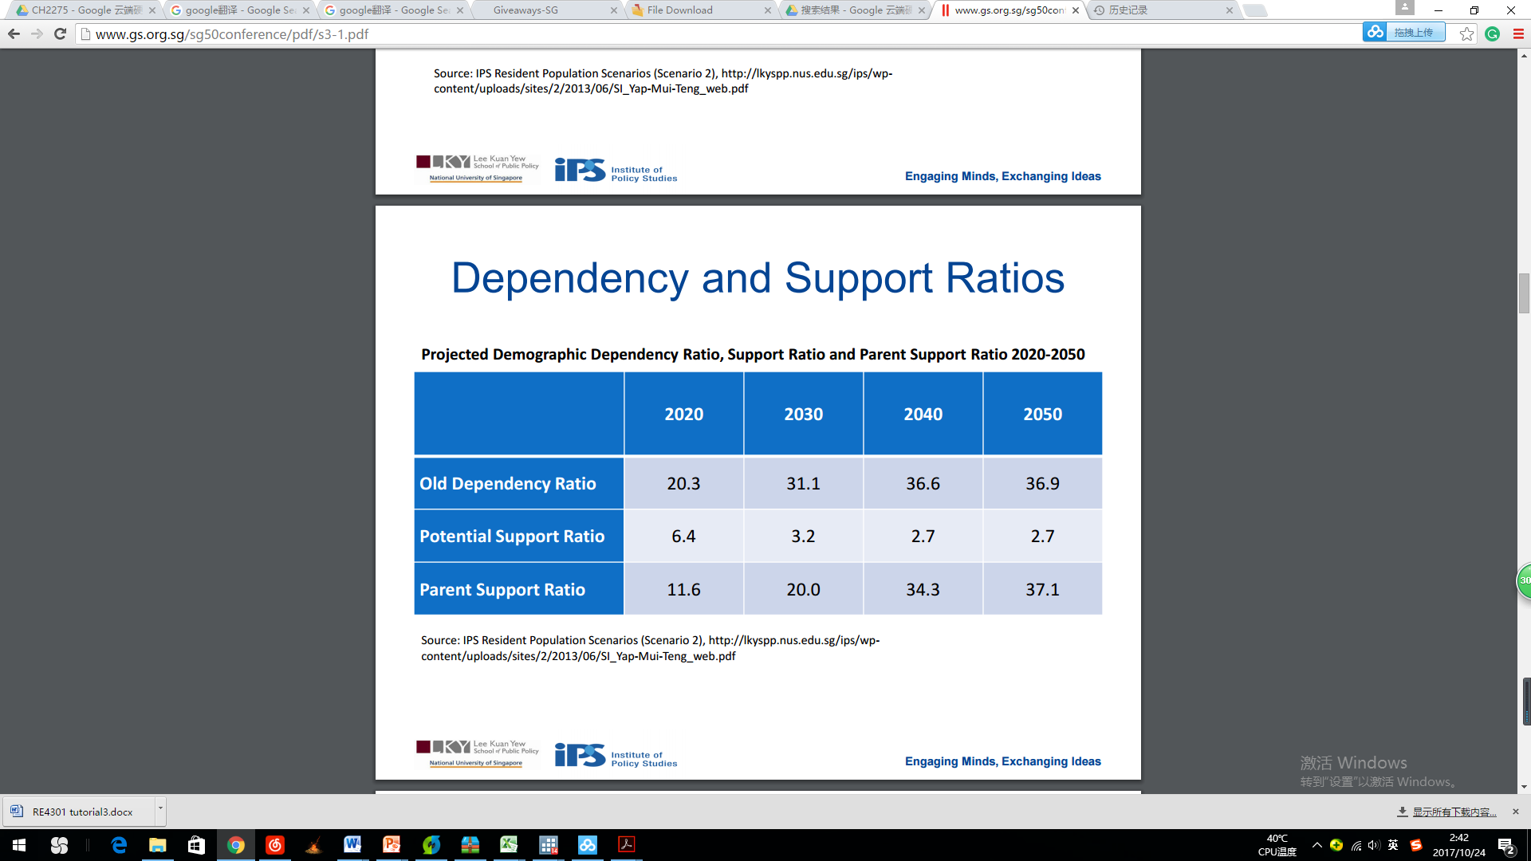
Adverse impact on old-age dependency and potential support

Slide 6
Rapidly ageing population with doubling in the number of 65+ in the past 20 years, and another doubling projected in the next 15 which cause Adverse impact on old-age dependency and potential support
The old dependency ratio is the number of persons aged 65 or older per one hundred persons 15 to 64.
The potential support ratio is the number of persons aged 15 to 64 per every person aged 65 or older.
The parent support ratio is the number of persons 85 years old and over per one hundred persons 50 to 64 years.

Slide 7
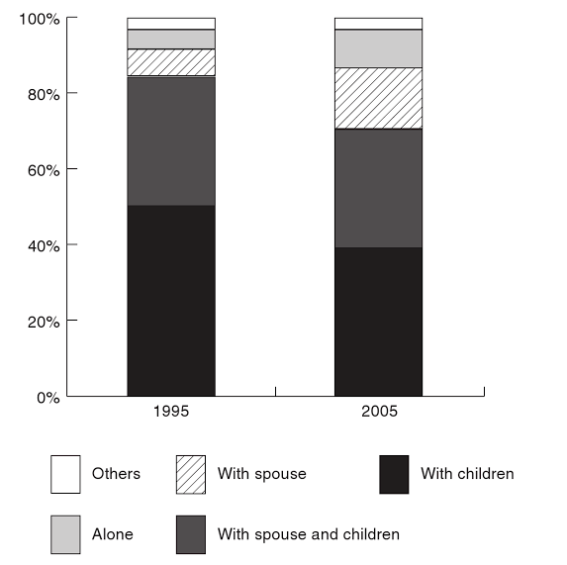
Adverse impact on old-age dependency and potential support
No. of single seniors and single-person households | 1995 | 2011
+55 and single | 3.1% | 14.9%
+75 and single | 4.4% | 16.6%
Source: IPS, 2013
Exacerbated by:
Rising number of single seniors and single-person households
According to Singapore Department of Statistics, total number of single seniors is expected to jump from 35,000 [2012] to 92,000 [2030]
Rising demand for independent ageing among baby boomers (born between 1947 to 1964)
77% of baby boomers prefer living independently
Only 18% of elderly with university and higher education want to live with their children
Living arrangements of elderly persons (aged 65 and older) shows increase in those living alone.
Source: National Survey of Senior Citizens, 1995, 2005
Notes:
http://www.todayonline.com/singapore/elderly-living-alone-higher-risk-dying-prematurely-study
https://books.google.com.sg/books?hl=en&lr=&id=FTqLBQAAQBAJ&oi=fnd&pg=PA104&dq=Can+Singapore’s+Central+Provident+Fund+still+meet+retirement+income+needs%3F&ots=3cep7_yeJQ&sig=Vd7KbZa0Q8kKahfEqNcoTK-f3do#v=twopage&q=Can%20Singapore’s%20Central%20Provident%20Fund%20still%20meet%20retirement%20income%20needs%3F&f=true
http://www.straitstimes.com/singapore/health/call-for-more-housing-options-beyond-nursing-homes-for-seniors
http://www.straitstimes.com/singapore/first-retirement-village-opens-in-singapore-in-december
IPS, 2013
Get evidence from Prof Joo for point 3

Slide 8
2. Pension problem
What is pension problem: Have difficulty to accumulate CPF savings to fund an adequate pension, despite very high contribution rates. Hence, CPF impacts old-age income security.
Possible Reasons:
Under the current system, the CPF allows its account holders to make withdrawals for housing, medical and education.There is no effective limit to the amount that can be withdrawn. This leaves many Singaporeans cash-poor and asset-rich when they retire because they've put too much money into housing.
Proportion of withdrawal for retirement rose from 18% in 2005 to 32% in 2010, but withdrawal for public housing was similar at 38% and 36% on aggregate level - CPF Board 2005/2010).
Notes:
怎么样造成这个局面& 为什么
Ng KH. (2015). Can Singapore’s Central Provident Fund still meet retirement income needs? In M. Sherraden, L. Zou, H. Ku, S. Deng & S. Wang (Eds.), Asset-building policies and innovations in Asia(pp. 104–22). Oxon: Routledge.
CPF supports three basic needs (1) Housing (2) Healthcare (3) Retirement income.
Reason: CPF supports 3 basic needs
2) Low administered borrowing interest rates act as further incentive.

Slide 9
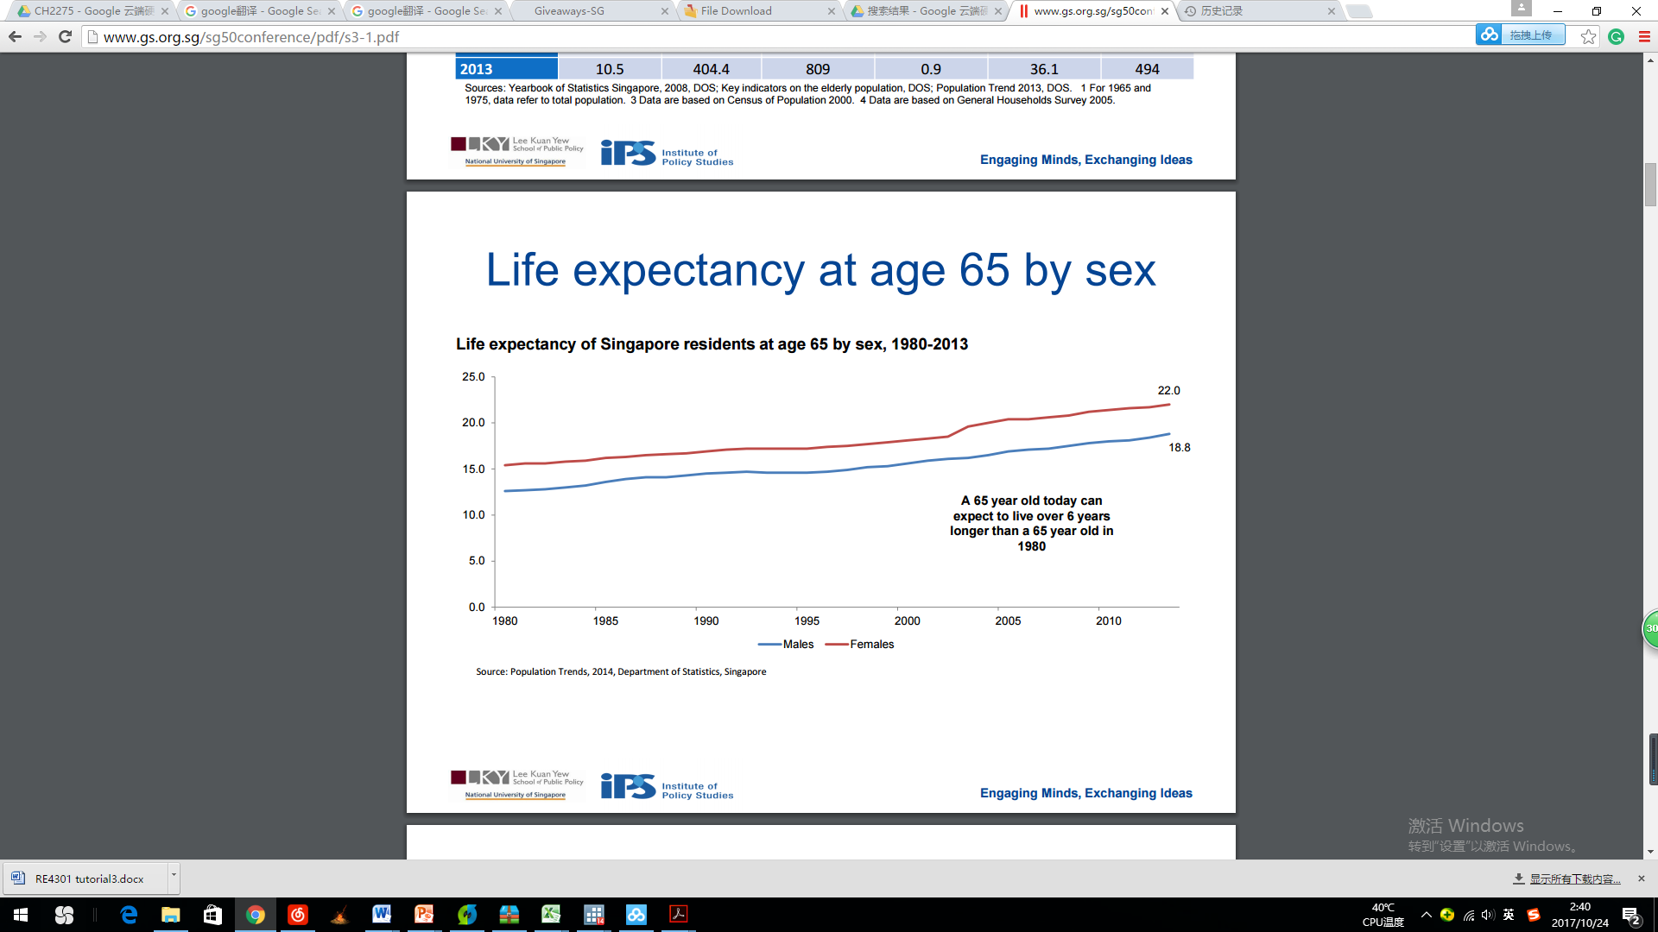
2. Pension problem
CPF system was designed for a time when Singaporeans were expected to live at most 20 years after retirement. However, Increased longevity of elders yet they are asset-rich, cash-poor. projected amount of CPF savings is not enough
Notes:
(Ng, 2017) http://www.straitstimes.com/opinion/many-working-out-of-need-not-out-of-choice

Slide 10
pension problem generated by withdrawal CPF
In the early days, in order to boost the demand and homeownership, Singapore government allowed people to use CPF to pay off down payment as well as monthly mortgage repayment. Although the short term impact is very strong and successful, we are facing a very serious aging problem which is the negative impact caused by policy.
88% (or about 40,000) of HDB households with the youngest lessee aged 65 years and above have fully discharged their HDB mortgage loans. A significant number of these seniors are ‘asset-rich, cash-poor’.Increased life expectancy amongst the elderly will make this problem worse.
While ultra-high home prices make Singaporeans seem wealthier on paper, many retirees don’t have enough liquid savings to ensure a comfortable retirement—what Hui Wen Tat, professor at NUS’ Lee Kuan Yew School of Public Policy, calls being “asset-rich, but cash-poor.” Property now makes up around 75-80% of Singaporeans’ net retirement wealth

Slide 11
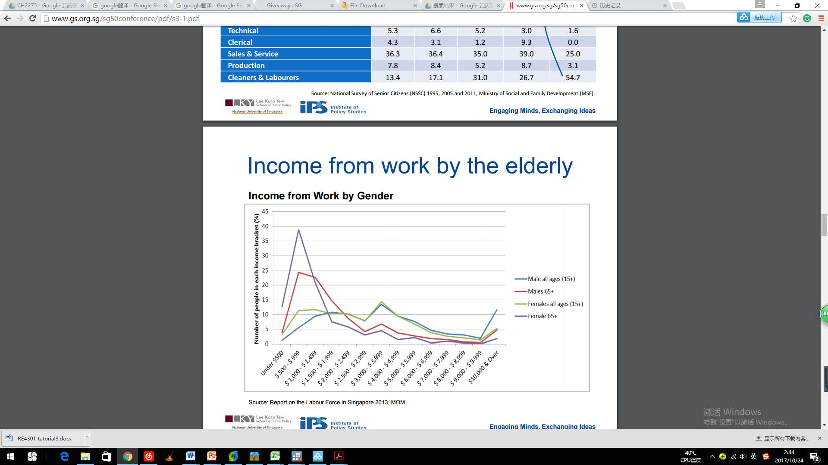
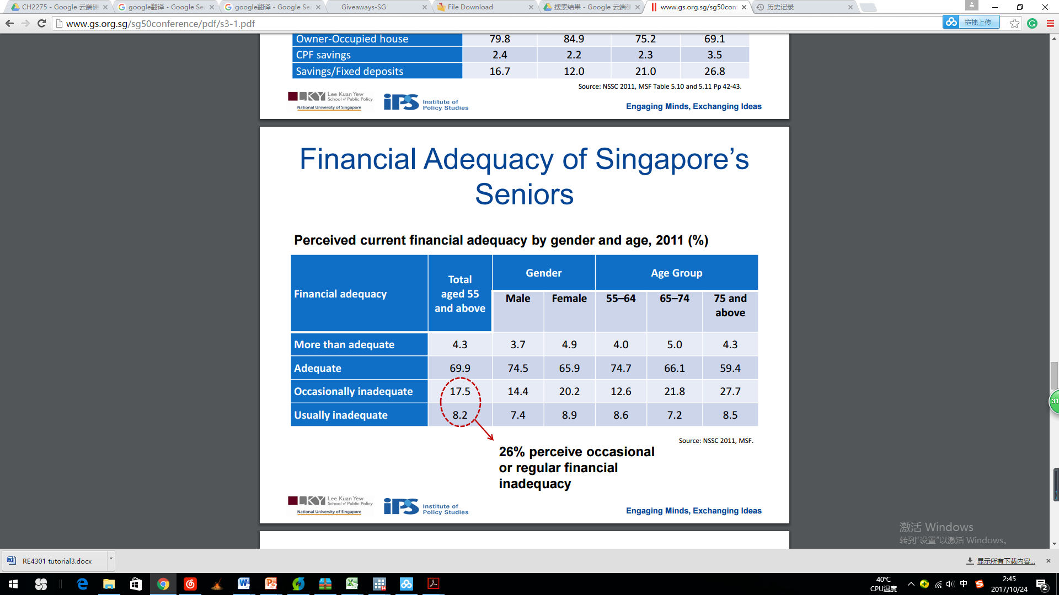
3.Low income

Slide 12
Low income of Senior citizens is also a problem facing by the government. By looking at the graph on the left hand side, we can observe that majority of Male and Female above 65 are earning a monthly income lower than 1000 SGD. Also, From the financial adequacy research by 2011. About 26% of residences above 55 years old is occasional or regular financial inadequacy.
Trend-over-time analysis of % of low income group amongst elderly (defined as subjective) and how much % housing stock allocated to them
"The deeper structural problem is that we have quite a large group of Singaporeans who cannot afford to retire based on their savings alone,
retirement inadequacy is a pressing issue which requires a "fundamental restructuring" of the CPF system.

Slide 13
4.Shortage in supply & lack of housing options for single elderly
Lack of Housing options
Shortage of Nursing Homes beds
Notes:
http://www.gs.org.sg/sg50conference/pdf/s4-1.pdf

Slide 14
The number of elderly living alone increased from 6,000 in 1990 to 29,000 in 2011 and is estimated to reach 92,000 by 2030.If these people find themselves in need of a place to live they can check themselves into only a nursing home now because there are hardly any other types of housing options available.In countries such as the United States, Australia and Finland, about 5 per cent of the elderly population live in some form of residential aged care facility in the community.
Going by the same estimation, that would mean about 50,000 seniors in Singapore needing such facilities by 2030, though there is only about 12,000 nursing home beds now.
Integration of facilities
There is currently a lack of an integrated approach in providing for the needs of the elderly. The current studio apartment scheme by HDB are not sufficient to cater to the higher expectations of the more well-off and well-educated elderly, who would have higher expectations for housing, including provision of integrated support facilities.Only by expanding the range of housing options available to the elderly to include retirement estates integrated with support facilities for the elderly can then cater to the growing needs and expectations of Singapore’s rapidly growing ageing population.

Slide 15
Implications to housing policy:
What can we do?
Family is the key
Fundamental restructuring of the CPF system
Work longer before retiring
Provide more housing options
Creating a Barrier-free and Elderly Friendly Environment
Get more retirement benefits from the same asset (home)

Slide 16
Implication to housing policy:
What can we do?
1.Family is the key
Family is a key source of physical, emotional and financial support for the elderly. Strong family and community ties for seniors should be built to enjoy their silver years
We should introduce more schemes to encourage Nuclear and 3G family
2.Fundamental restructuring of the CPF system
CPF system must go beyond tweaks to the withdrawal age and minimum sum, to address the structural problem of retirement inadequacy and returns on CPF funds
3.Work longer before retiring
Increasing retirement age - require less financial support - less worry about retirement adequacy
Notes:
https://www.imf.org/external/np/seminars/eng/2013/oapfad/pdf/asher.pdf
http://www.businesstimes.com.sg/government-economy/singapore-budget-2015/cpf-rethink-needs-to-address-structural-retirement

Slide 17
Currently, Singapore has High Pre-Retirement Withdrawals ( use all OA for down payment as well as monthly mortgage payment)
For the 1997-2011 period, the withdrawals averaged 74.9 percent of the contributions .
Singaporeans seem wealthier on paper, many retirees don’t have enough liquid savings to ensure a comfortable retirement. Property now makes up around 75-80% of Singaporeans’ net retirement wealth
Men aged 55 to 59 had far greater expectations to work full-time past 65 and 70 than employees currently do, while women had higher such projections beyond 62, 65, and 70, according to the latest survey by the Singapore Management University's Centre for Research on the Economics of Ageing, which works with the US-based Rand Corporation.

Slide 18
Implication to housing policy:
What can we do?
4. Provide more housing options
The number of elderly living alone increased from 6,000 in 1990 to 29,000 in 2011 and is estimated to reach 92,000 by 2030. However, there is hardly any other housing options for elderly Singaporeans besides nursing homes.
In countries such as the United States, Australia and Finland, about 5 per cent of the elderly population live in some form of residential aged care facility in the community.
Going by the same estimation, that would mean about 50,000 seniors in Singapore needing such facilities by 2030, though there is only about 12,000 nursing home beds now.
Notes:
https://www.imf.org/external/np/seminars/eng/2013/oapfad/pdf/asher.pdf
http://www.straitstimes.com/singapore/health/call-for-more-housing-options-beyond-nursing-homes-for-seniors

Slide 19
Implication to housing policy:
What can we do?
5.Creating a Barrier-free and Elderly Friendly Environment
Ramping up infrastructure, with new hospitals, more institutional care options
At the neighbourhood level, as far as possible, a network of barrier-free and vehicular-free walkways should be provided to connect each precinct to the amenities within its neighbourhood.
6.Get more retirement benefits from the same asset (home)
Life annuity & reverse mortgage to monetize the house - have enough money to be financially independent
Notes:
https://www.bca.gov.sg/BarrierFree/others/HDB.pdf

Slide 20
Policies in place
2
Past/current policies (Trend over time/space)
Regulation Provision Subsidy
Notes:
2. Document the past and the current policies, e.g. retirement village and lease buyback scheme and other related topics. (20 marks)

Slide 21
Policies in place
PROVISION: 1) Lease buyback scheme
PROVISION: 2) Ageing-in-place initiative
PROVISION: 3) Right Sizing Scheme
PROVISION: 4) Rental housing
SUBSIDY: 1) Deferred Downpayment Scheme

Slide 22
PROVISION: 1) Lease buyback scheme
Content of solution | Through this scheme, you will be able to tap on your flat to receive a stream of income in your retirement years, while continuing to live in it.You can sell part of your flat’s lease to HDB and choose to retain the length of lease based on the age of the youngest owner. The proceeds from selling part of your flat’s lease will be used to top up your CPF Retirement Account (RA). You can then use your full CPF RA savings to purchase a CPF LIFE plan, which will provide you with a monthly income for life. Restrictions: 1.Flat type:4-room or smaller flat (Three-room HDB flat owners still receive S$20,000 for participating in the LBS, while four-room HDB flat owners receive a bonus of S$10,000.) 2.Property Ownership:No concurrent ownership of second property 3.Income:Gross monthly household income of $12,000 or less 4.Minimum Occupation Period:All owners have been living in the flat for at least 5 years 5.Minimum Lease:At least 20 years of lease to sell to HDB
Institutional arrangement | HDB
Target population | Owner who is a Singapore citizen aged 64 or older.
Notes:
IMC, 1999 source
Government safety net (Mehta, 2002; 2006)
The HDB introduced the Lease Buyback Scheme (LBS) in 2009 marking the entry of the government in providing homeowners an option for monetizing their housing wealth, enhanced the scheme in 2015.

Slide 23
Predecessor of Lease Buyback Scheme was Reverse Mortgage Scheme
For private housing homeowners [1997] but was discontinued by financial institutions NTUC Income [1997-2009] and OCBC Bank [2006-2009]
Limitations of the policy:
Conditions for borrowers in the reverse mortgage schemes were fairly complicated
Lenders wanted properties with long remaining leases as collateral, so that in a leasehold setting, fewer households were eligible to apply for the reverse mortgage.
Comparing to Free-hold in Uk US and Australia, Singapore Lease-hold issue is more complicated and less valuable.
Resulting in lack of demand from borrowers
PROVISION: 1) Lease buyback scheme
Notes:
.

Slide 24
The private sector in Singapore initially provided households an option for monetizing their housing wealth. NTUC Income, an insurance firm, introduced a reverse mortgage scheme for private housing homeowners in 1997. A reverse mortgage allows homeowners to borrow money using their home equity as collateral. In 2006, OCBC Bank joined NTUC Income in offering reverse mortgages. However, both institutions discontinued their schemes by 2009 due to a lack of demand from borrowers. Among the reasons for the low demand were: i) conditions for borrowers in the reverse mortgage schemes were fairly complicated, and ii) lenders wanted properties with long remaining leases as collateral, so that in a leasehold setting, fewer households were eligible to apply for the reverse mortgage

Slide 25
PROVISION: 2) Ageing-in-place initiative
Ageing in place means growing old in the home and community that one is familiar with, amidst family and community support. (Inter-Ministerial Committee on the Ageing Population (IMC), 1999)
Prioritising family as compared to government as first in line of support (medical/ financial/ wellbeing)
VS. State support via Modernization Theory that expects industrialisation and development to gradually replace traditional familial care arrangements with solidaristic provisions of the welfare state (Cowgill 1972)

Slide 26
Examples of Ageing in Place initiative
‘Studio Apartment Priority Scheme’ and ‘Senior Priority Scheme’ gives priority to elderly residents who want to age in place in familiar environment or live near their married children/parents, in a 2-room Flexi flat. The length of lease is flexible based on age/needs/preference, between 15-45 years in 5-year increments, as long as it covers you and your spouse up to age of at least 95 years. (Applicable for HDB only)
Married Child Priority Scheme (MCPS) for parents to live closer to their married children either in the same flat, same estate, or in a neighbouring estate.This makes it easier for children to care for their parents. (Applicable for HDB and DBSS) Multi-Generation Priority Scheme (MGPS) for married children to apply for new flats in the same precinct as their parents, via a joint application for 2 flats in a BTO project where 2-room Flexi or 3-room flats are integrated in the flat mix.(Applicable for HDB only)
Retirement Kampung with 104 30-year leased studio and two-room flexi flats (36-45 sqm) with in a self contained environment at Kampung Admiralty [July 2014 BTO] for elderly >55 y/o. More than 40% booked under SPS, with about 60% residents in nearby towns such as Woodlands/ Sembawang/ Yishun. Upcoming 10 build-to-order projects with childcare (take care of grandchildren)/medical/hawker center and communal spaces (socialise). Studios lease $91,000-115,000.
PROVISION: 2) Ageing in place initiative
Notes:
refers to growing old in the home, community and environment that one is familiar with, with minimal change or disruption to one’s lives and activities. This is to promote social integration where the needs of seniors can be met within the community, rather than to segregate them as a distinct and separate group of the population.

Slide 27
Retirement village is best of both worlds
Escape the pension problem
Asset rich cash poor elderly above 55 years old can potentially escape pension problem if they had downgraded from a flat (resale price range from $165,000 to $357,000 for 3-room to executive flat) and purchased this lower priced 30-year lease (studios lease $91,000-115,000).
2. In line with elderly sentiments
A lower proportion of elderly residents felt it ideal to move in with their children as compared to younger married residents. - Ministry of Social and Family Development They preferred to live in their own homes, with increased caregiving.
Retirement Kampung would widen the option of caregiving from 1) Family members 2) Domestic helpers to 3) Communal support.
PROVISION: 2) Ageing-in-place policies
Notes:
https://www.msf.gov.sg/research-and-data/Research-and-Data-Series/Documents/Ageing%20Families%20Report%20Insight%20Series%2020151124.pdf Ministry of Social and Family Development (MSF)’s Insight Series Paper 02/2015 on ‘Ageing families in Singapore’

Slide 28
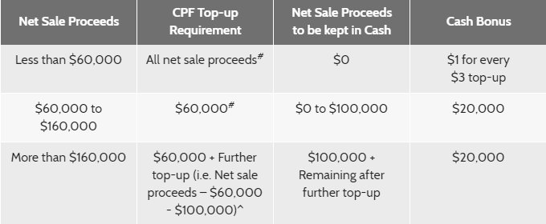
PROVISION: 3) Right Sizing Scheme
Content of solution | If you own a bigger flat type, you can choose to right-size your flat and use your net sale proceeds to supplement your retirement income (CPF Retirement Account) through the Silver Housing Bonus (SHB) scheme. This is because the demand of housing space changes as people age. Eligible housing types: 1) Smaller HDB flat (2-room Flexi or 3-room flat). 2) Purchase price does not exceed selling price of existing property. 3) From resale market. Net sale proceeds are refunded back to CPF account. Restrictions: 1) Within 6 months of completing sale of existing property 2) Meet Minimum Occupation Period for resale 3) Own private property of Annual Value of $13,000 or less 4) No concurrent ownership of second property.
Institutional arrangement | HDB
Target population | Owner who is a Singapore citizen aged 64 or older.

Slide 29
Smaller HDB flat (2-room Flexi or 3-room flat). Purchase price does not exceed selling price of existing property. *Net sale proceeds = Selling price of existing property less any outstanding loan on existing property, refund to CPF Account, resale levy, deductible of up to $15,000 for ancillary costs, and cash used for purchase of next property.You can apply for the SHB and receive up to $20,000 cash bonus per household

Slide 30
SUBSIDY: 1) Deferred Downpayment Scheme
Content of solution | The scheme enables elderly who are right-sizing to defer the payment of downpayment until key collection. This will help to ease the cash flow for elderly flat owners whose funds are tied up in their existing flat, and smoothen the rightsizing process. Eligible flat buyers will only need to pay the stamp duty and legal fees when they sign the Agreement for Lease, about 4 months after booking a flat. They will pay the purchase price of the flat once it is ready for key collection.
Institutional arrangement | HDB
Target population | 1.Are aged 55 years old and above 2.Have booked a 2-room Flexi or 3-room uncompleted flat in a mature or non-mature estate 3.Have not sold or completed the sale of their existing flat at the point of new flat application

Slide 31
Smaller HDB flat (2-room Flexi or 3-room flat). Purchase price does not exceed selling price of existing property. *Net sale proceeds = Selling price of existing property less any outstanding loan on existing property, refund to CPF Account, resale levy, deductible of up to $15,000 for ancillary costs, and cash used for purchase of next property.You can apply for the SHB and receive up to $20,000 cash bonus per household

Slide 32
Our stand: Singapore has done well overall in provision and subsidy, e.g. right-sizing is a policy not many countries have.

Slide 33
Compare internationally &
Recommend policies
3
Application to Singapore
Notes:
3. Compare and evaluate the current policies in light of international elderly housing policies (50 marks)
Content (subsidy/provision)
Institutional arrangement
Target audience

Slide 34
Assumption: We believe that lack of options is caused by lack of demand, due to lack of capital. Developers would build quality customised elderly residence if there were demand.

Slide 35
Impact of demographic ageing on Welfare State differs from that of Non-Welfare State
Mature EU welfare states
Less contributions by working-age population
Greater expenditure to payout benefits
Concern is balancing financial sustainability of pension system with adequate benefits for individuals
Non-welfare states
Depend more on informal support from family
Effect is internalised within the family (future cohorts have less adult children to depend on)
-> When using EU Welfare states as comparable (not recommended), note differing considerations.
Notes:
(OECD, 2013) OECD. Pensions at a Glance 2013: OECD and G20 Indicators. Paris: OECD Publishing, 2013.

Slide 36
Compare & Recommend Policies
Unlock housing equity
Provide more supply & housing options
Solve pension problem of inadequate savings

Slide 37
Case 1 US vs SG
Unlock housing equity

Slide 38
US Reverse Mortgage VS SG LBS
 | US Home Equity Conversion Mortgage (HECM) | SG Lease Buyback Scheme (LBS)
Time | 1987 | 2009; enhanced in 2015
Content (provision) | 1.Provide loan on value of a property, paid as a lump sum or in fixed monthly instalments. 2.Borrowers are charged an upfront insurance premium at 0.5-2.5% house value and monthly mortgage insurance premium (MIP) at annual rate of 1.25% of loan’s outstanding balance. MIP can be financed as part of their loan. 3. Option to add a line of credit (a personal account controlled by the borrower to decide when to make cash withdrawal and how much to withdraw.) | 1. Homeowners sell tail-end lease of homeowner’s flat to HDB, and receive up to $20,000 or $10,000 of LBS bonus to top-up the Retirement Account (RA). This generates up to 5% interest annually. 2. Homeowners do not pay insurance premiums. 3. Homeowners have no access to a line of credit (ready cash).

Slide 39
The initial MIP will be .5 percent or 2.5 percent, depending on your disbursements. Over the life of the loan, you will be charged an annual MIP that equals 1.25% of the outstanding mortgage balance.
HECM was developed to solve (1) allow conversion of home equity into liquid asset to meet special needs of elderly homeowner (2) encourage and increase participation of primary and secondary mortgage market in coverting home equity into liquid asset (3) find extent of demand for home equity conversion, and types of home equity conversion mortgages that best serve needs of elderlyhouseholds. (Szymanoski, 1994)
Mayer and Simons (1994 a, b), Case and Schnare (1994), Merrill, Finkel, and Kutty (1994), and Fratantoni (1999) provide evidence of the strong demand for reverse mortgages among “house- rich, cash-poor” elderly homeowners in the U.S..
This work by providing a loan on the value of a property. The loan is paid as a lump sum and/or in monthly instalments. The company recovers the debt by selling the property after the homeowner has died or when the homeowner sells the property

Slide 40
US Reverse Mortgage VS SG LBS
 | US Home Equity Conversion Mortgage (HECM) | SG Lease Buyback Scheme (LBS)
Institutional arrangement | Enforcer: Department of Housing and Urban Development (HUD) Insurer: Federal Housing Administration Mortgage Insurance Program (fed govt) | HDB.
Target Audience | 62 years of age or older | 64 years of age or older
Learning Point: Offer reverse mortgage scheme for elderly private condominium homeowners with one paid condominium ($maintenance fee), enforced by a new Dept in URA and insured with NTUC/bank. Tap latent demand, after termination of RMS in 2009, from changes in housing policies [e.g. no concurrent ownership (apply HDB 30 month after sale)]. Allow option of a line of credit in LBS to allow cash withdrawal from Retirement Account. Emphasise that payments are backed by government. Amongst three US reverse mortgage products, over 95% reverse mortgage borrowers choose HECM (insured by the US fed government) over those by private entity (Ballman, 2004)
Notes:
.

Slide 41
And the two other products guaranteed by private entities [Fannie Mae, the largest non-banking financial services company in the world, guarantees the Home Keeper Mortgages, and Financial Freedom, currently the largest private reverse mortgage lender and servicer in the U.S., guarantees the Cash Account] only takes up less than 5%. (Ballman, 2004).
While ultra-high home prices make Singaporeans seem wealthier on paper, many retirees don’t have enough liquid savings to ensure a comfortable retirement, so they are being “asset-rich, but cash-poor.” The only way households can benefit from those higher prices is if they sell their homes but most Singaporeans don’t want to leave the homes they worked their whole lives to own. 2014.(Tan Yunyou).In this case, LBS is a ideal way to ensure residence both can leave in there original property but also get financially supported.
LBS is a process which unitholders sell the tail lease to top up the Retirement Account. Because the RA monthly payment a fixed monthly amount, the real value of the cash paid to them monthly is likely to decline over time because of inflation

Slide 42
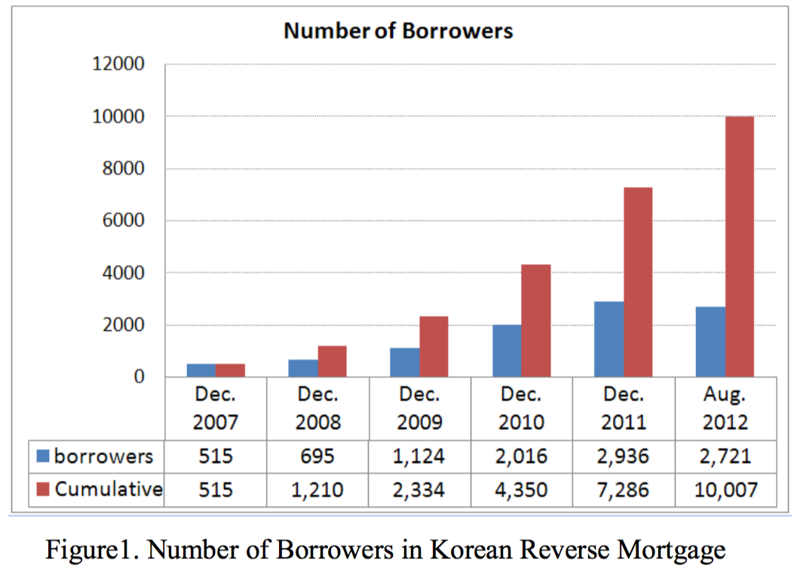
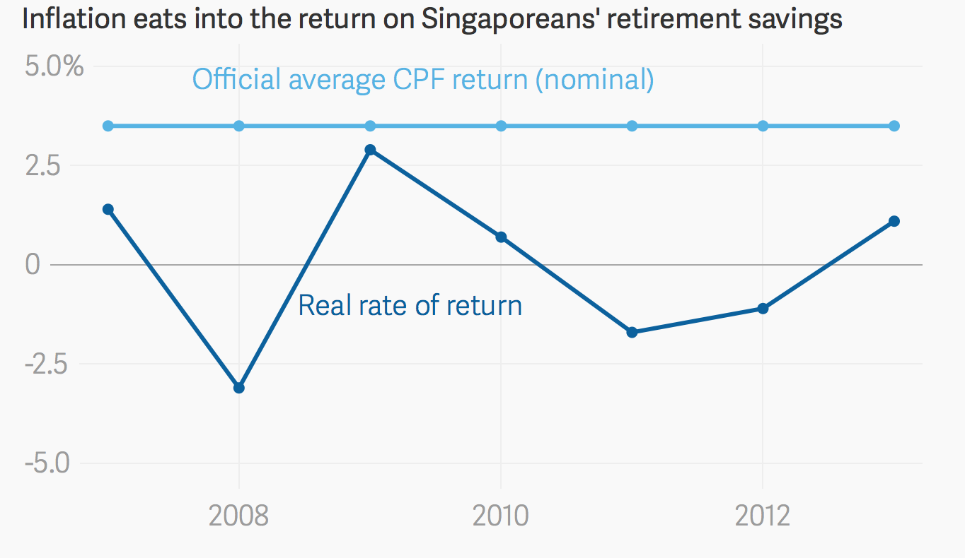

Recommendation: Inflation hedge against Lease Buyback Scheme
Reason:
Improve the real rate of returns (from saving with CPF).
x2
Source: Seungryul, M., & Yongheng, D. (2011)
Source: https://www.theatlas.com/charts/Vy4r_ECP

Slide 43
As we can see this through this graph that Half of the time The Real rate of Return is Below zero. Hence the interest rate generated by the CPF account can hardly against the Inflation. Hence introduce of MIP is necessary
Guilford, G. (2017). A blogger questioned the Singapore miracle, and the prime minister is tårying to bankrupt him. [online] Quartz. Available at: https://qz.com/497287/singapore-blogger-roy-ngerng-sued-by-prime-minister-lee/ [Accessed 30 Oct. 2017].

Slide 44
For all its obvious benefits, the reverse mortgage program presents a number of risks to both
1.LBS provide a lump sum amount of Money to top up the Retirement Account to provide a steady amount of Pension.
2.The Top-up through LBS may
While ultra-high home prices make Singaporeans seem wealthier on paper, many retirees don’t have enough liquid savings to ensure a comfortable retirement, so they are being “asset-rich, but cash-poor.” The only way households can benefit from those higher prices is if they sell their homes but most Singaporeans don’t want to leave the homes they worked their whole lives to own. 2014.(Tan Yunyou).In this case, LBS is a ideal way to ensure residence both can leave in there original property but also get financially supported.
LBS is a process which unitholders sell the tail lease to top up the Retirement Account. Because the RA monthly payment a fixed monthly amount, the real value of the cash paid to them monthly is likely to decline over time because of inflation.

Slide 45
Case 2 South Korea vs SG
Unlock housing equity

Slide 46
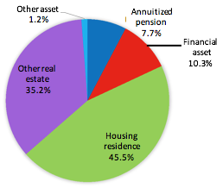
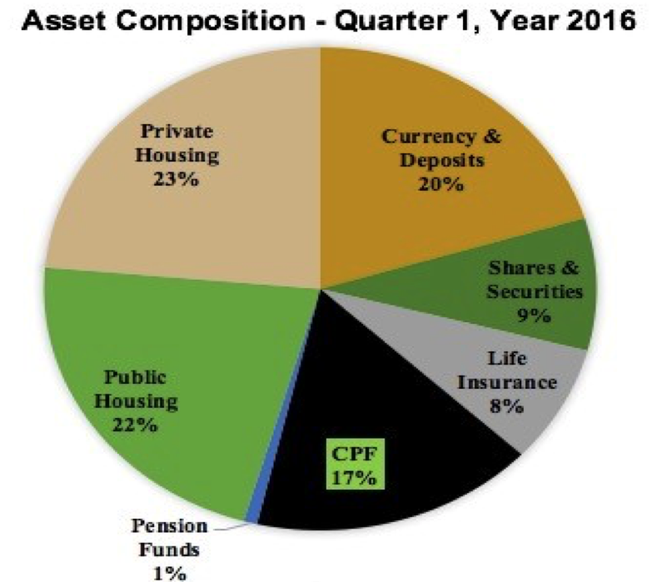
Singapore v.s. Hong Kong
Wealth Composition of “Retirement-age” households shows that:
Korea face similar issue of asset rich cash poor
Composition of household wealth (%) for Korea married couple at retirement age
Source: Poterba, Venti, Weiss (2011) . And Kim, Kim, Lee and Cho (2016)
Singapore Household sector balance sheet
Source: Singapore Statistics

Slide 47
About 35%% of elderly people,, many of them living alone,, are in absolute pov erty based on the disposable income criterion . The relative poverty rate among people aged 65 years and above is 49%% — more than three times higher than the rate for all age groups,, which is 15%% (KKIHSA 2014)).

Slide 48
Korea Joo Taek Yeon Keum VS SG LBS
 | Korea Home Pension Scheme | SG Lease Buyback Scheme (LBS)
Time | 2007 | 2009; enhanced in 2015
Content (provision) | [2007] Set-up tenure plan with fixed monthly payments till the borrower dies/ sell their home, or permanently move away. Upfront insurance premium (2% house value) is higher than US’ but mortgage insurance premium is lower (0.5% of outstanding balance/annum). + line of credit. [2008] Borrower can choose from graduated monthly payments indexed to the growth rate of consumer prices OR decreasing monthly payment, on top of fixed. | Not designed to fully protect against inflation. This decreases security of the real value of cash paid to the borrower.

Slide 49
Finding: Sometimes, low-take up rate is due to limits on eligibility.
Evidence:
Lowering the age cohort requirement in 2008 and widening upper limit of house value (average 278M won) doubled take-up rate.
x2
Source: Seungryul, M., & Yongheng, D. (2011)
Notes:
Seungryul, M., & Yongheng, D. (2011). Evaluation of Reverse Mortgage Programs in Korea. IRES Working Paper Series, 2011-027. Retrieved from http://www.ires.nus.edu.sg/workingpapers/IRES2011-027_new.pdf

Slide 50
Korea Joo Taek Yeon Keum VS SG LBS
 | Korea Home Pension Scheme | SG Lease Buyback Scheme (LBS)
Institutional arrangement | Enforcer: National Housing Fund Insurer/Guarantor: Korea Housing Finance Corporation (Govt-owned) | HDB
Target Audience | Lowered from 65 to 60 years old Own their home with house value ranging from below 100 million won to above 500 million won | 64 years of age or older
Learning Point: Widen the age cohort to include pre-elderly of 60-64 years-old and lower limit of house value types. How popular is graduated payments (inflation hedge)? Surprisingly, as at 2012 bulk of borrowers still went with constant payment option (76.5%), then decreasing (22.6%)/ graduated (0.9%). Perhaps fear deflation = lower payouts. However, an option is better than no option.

Slide 51
Upfront insurance premium at 2% of house’s value and monthy mortgage insurance premium (MIP) based on annual rate of 0.5% of loan’s outstanding balance.
While ultra-high home prices make Singaporeans seem wealthier on paper, many retirees don’t have enough liquid savings to ensure a comfortable retirement, so they are being “asset-rich, but cash-poor.” The only way households can benefit from those higher prices is if they sell their homes but most Singaporeans don’t want to leave the homes they worked their whole lives to own. 2014.(Tan Yunyou).In this case, LBS is a ideal way to ensure residence both can leave in there original property but also get financially supported.
LBS is a process which unitholders sell the tail lease to top up the Retirement Account. Because the RA monthly payment a fixed monthly amount, the real value of the cash paid to them monthly is likely to decline over time because of inflation.

Slide 52
(2) Provide more Supply & Housing Options

Slide 53
Previously on Shortage of Supply & options
Lack of Housing options
Shortage of Nursing Homes beds
Notes:
Vjr Housing http://www.singaporebudget.gov.sg/budget_2012/download/Category1/VJ2_Housing.pdf

Slide 54
Integration of facilities
There is currently a lack of an integrated approach in providing for the needs of the elderly. The current studio apartment scheme by HDB may not be sufficient to cater to the higher expectations of the more well-off and well-educated elderly, who would have higher expectations for housing, including provision of integrated support facilities. This policy will build upon the existing strengths of public housing for Singaporeans, by expanding the range of housing options available to the elderly to include retirement estates integrated with support facilities for the elderly, so as to cater to the growing needs and expectations of Singapore’s rapidly growing ageing population.

Slide 55
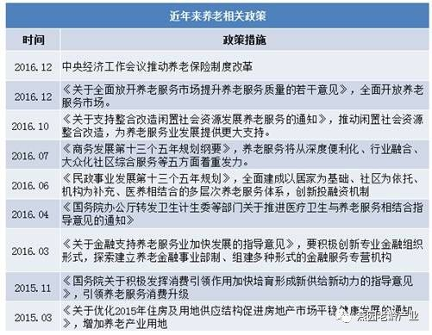
China 13th Five-Year Plan VS SG
 | China 13th Five-Year Plan | SG
Time | 2016 | NA.
Content (provision) |  | No Such policy currently
Notes:
http://www.360doc.com/content/17/1013/20/34279512_694693308.shtml
中国健康养老产业发展报告
http://news.xinhuanet.com/gongyi/yanglao/2017-01/22/c_129457771.htm
http://www.businesstimes.com.sg/real-estate/room-to-grow-senior-housing-projects-in-singapore-but-challenges-remain-study

Slide 56
China Senior Housing market is an good example to show how can the market could be boosted by subsidy provided by Government policy.
1.Subsidy in land for elderly care use
2.Provide a portion of land of Commercial use in land of elderly care use
According to communities such as those in the US provide amenities and space to meet the needs of older residents, the Scarcity and associated cost of land in Singapore hinder the development of such communities, with neighbouring countries more likely to offer better options.
Such projects are also likely to be less accessible to middle and lower-income individuals in Singapore."If Singapore were to build such active adult communities vertically, it would only be affordable to individuals who are in the middle-upper income bracket. The buyers are likely to come from retiring private-home owners," the report said.

Slide 57
China 13th Five-Year Plan VS SG
 | China 13th Five-Year Plan | SG
Institutional arrangement | National Development and Reform Commission | HDB
Target Audience | Developers | Developers
Learning Point: ”Preferential policies for land use“ should be introduced by government by either Provide proferrancial land price for elderly care use Provide a portion of land of Commercial use for subsidy in land of elderly care use
Notes:
http://www.businesstimes.com.sg/real-estate/room-to-grow-senior-housing-projects-in-singapore-but-challenges-remain-study

Slide 58
According to the data published by Department of social service development in 2015, the various types of senior Service organization and facilities reach a number of 116 thousand, reach a growth of 23.4% Comparing to the previous year; the number of nursing home beds grew 16.4% compared with the previous year
After the 13th Five-Year plan being proposed, beds number was increased to 35-40.

Slide 59
(3) Solve pension problem of inadequate savings

Slide 60
Asset rich cash poor OR Asset poor cash rich
Range of payout options and corresponding retirement sum to be set aside for a member turning 55 in 2017. | Retirement Account savings required at 55 | Your monthly payout* for life from 65
If you own a property and choose to withdraw your Retirement Account savings above your Basic Retirement Sum (subject to sufficient CPF property charge/pledge) | Basic Retirement Sum (BRS) $83,000 | $700 - $750
If you do not own a property or choose not to withdraw your Retirement Account savings above your Basic Retirement Sum | Full Retirement Sum (FRS) $166,000 The FRS is 2 x BRS. | $1,280 - $1,380
If you wish to put more savings in CPF LIFE | Enhanced Retirement Sum (ERS) $249,000 The ERS is 3 x BRS. | $1,860 - $2,000
*Payout figures are estimates, based on the CPF LIFE Standard Plan and computed as of 2017.
Notes:
https://www.cpf.gov.sg/Assets/members/Documents/RetirementPayouts.pdf
https://www.cpf.gov.sg/members/schemes/schemes/retirement/retirement-sum-scheme
5what we need? rental market
6现有的rental market 虽然有，但是动机还是boost ownership( monthly income cap. 就是证据) – 照顾那些本来就买不起的outlier
7.所以政府需求mature 的public rental market ( standardized ; sense of security compared to private rental market ) ----
8. 现有很好的rental market 我们可以借来模板
9.Apply to Singapore

Slide 61
Why People Choose To Own A House?
Incentive
-HDB loan provides concessionary interest rate for home loans compared to private bank
-Eligible buyers can receive subsidies in the form of CPF Housing Grants of up to $80,000
-Cost to housing is low for the first-time buyer
-Allow CPF ordinary account with a relatively high rate to pay stamp duty,legal cost
-Mortgage-reducing insurance (HPS)
-You can use your CPF Ordinary Account (OA) savings to buy or build private residential property for occupation or investment(PPS) or buy more than one property.
-The prospect of housing price is rising

Slide 62
HPS protects members and their families against losing their HDB flat in the event of death, terminal illness or total permanent disability. HPS insures members up to age 65 or until the housing loans are paid up, whichever is earlier.​You will only need to pay annual premium for 90% of your HPS cover period. For example, if your HPS cover period is 30 years, you will only need to pay the premium for 27 years.

Slide 63
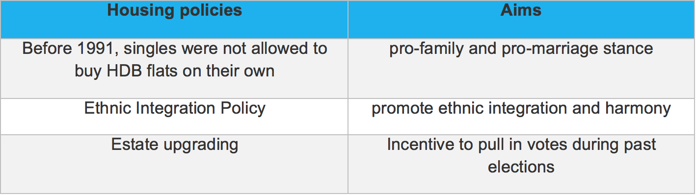
Homeownership As a Tool to Achieve Social and Political objectives
From 1964, the HDB began offering housing units for sale on 99-year leasehold basis, under its “Home Ownership for the People” scheme to create national identity and sense of belong among the people.
Mr. Lee Kuan Yew: “I wanted a home-owning society. I believed this sense of ownership was vital for our new society which had no deep roots in a common historical experience (Lee, 2000, pp. 116–117)”.
Through the application of eligibility conditions, public housing has been used to support certain government policies.
Side effect in the long term: pension fund problem
Notes:
http://eresources.nlb.gov.sg/infopedia/articles/SIP_1585_2009-10-26.html
https://ink.library.smu.edu.sg/cgi/viewcontent.cgi?article=2803&context=soe_research

Slide 64
Script : Before 1991, for instance, singles were not allowed to buy HDB flats on their own, in line with the government’s pro-family and pro-marriage stance.²⁰ However, the rule was gradually relaxed, initially giving singles access to three-room or smaller resale flats in certain areas, and later to such flats in any location. Now, single Singaporeans who are 35 years old or older can purchase resale flats of any size in any location on their own.²¹ Another example is the maximum proportion set for the ethnic composition in each HDB block and in each HDB neighbourhood. Known as the Ethnic Integration Policy, the scheme aims to promote ethnic integration and harmony. HDB will not approve the sale of a new or resale flat to a particular ethnic group if the sale would result in exceeding the ethnic quota of the block of flat.²²
Public housing services have also been linked to support for the ruling People’s Action Party (PAP). This is demonstrated in the PAP’s use of estate upgrading as an incentive to pull in votes during past elections. In July 2009, however, the government announced that the two opposition wards then – Potong Pasir and Hougang – would be included in HDB’s lift upgrading programme earlier than expected, prompting some to suggest that PAP was finally depoliticising the national upgrading programme.²³

Slide 65
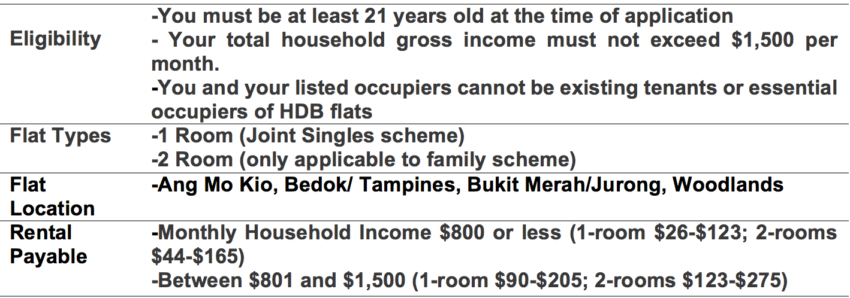
Current HDB Rental Market

Slide 66
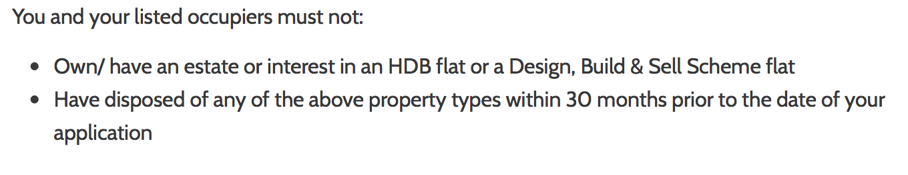
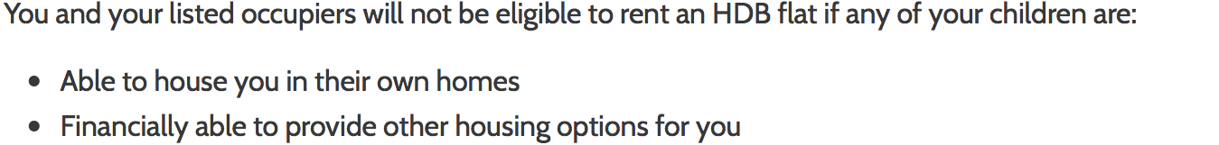
Restrictions of current public rental market
Policy Limitations
Tenure security
Lack of housing options
Notes:
http://www.hdb.gov.sg/cs/infoweb/residential/renting-a-flat/renting-from-hdb/public-rental-scheme
apart from the above mentioned, other limitation includes
tenure security
lack of housing options

Slide 67
Rental market in Switzerland
59% of people live in rental housing(mostly private market )although the country has high income level
-High cost of owning
-Rent Control & economic incentives
-No programmes to encourage savings for house purchase
-Tenant Protection
part of the rental housing stock—such as new construction or units vacated by their tenants—is typically exempt from controls
At the same time, economic incentives are usually offered for maintenance, and rent rises are allowed in response to inflation, rising costs and increases in housing prices.
-
Notes:
https://sites.tufts.edu/uep284chsustainabilities/files/2015/11/Home-ownership-and-rent-control-in-Switzerland.pdf
-High cost of owning caused by the taxation of imputed rent and capital gains
-Rent Control limits the landlord's ability to raise rents. At the same time,economic incentives are also offered for maintenance,and rent rises are allowed in response to inflation,rising costs and increasing in housing prices. => keep private rental housing profitable and attractive
-There are no programmes to encourage savings for house purchase
-Actions by landlord,which conflict with legislation-in particular,evictions,rent rises,and even excessive initial rents can be appealed against in rent administration board.If the appeal is accepted,the landlord cannot request an eviction or rent rise for another three years.
The rental sector has now been regulated for two-thirds of a century. Neverthe- less, privately owned rental housing continues to maintain its dominant role, and only 6.4 per cent of the rental stock is supplied by the state or by non-profit organisations.
At the same time, economic incentives are usually offered for maintenance, and rent rises are allowed in response to inflation, rising costs and increases in housing prices.

Slide 68
Conclusion
Learn policies from best-in-class (= usually longest history), especially how they solve/ did not solve unintended consequences from their policy.
Best-in-class is not good enough if complacency entombs a country’s capacity for renewal despite shifting demographic trends.
Welfare and non-welfare state face different challenges. Important to localise policies, and to focus on convenience for user rather than force them to change century-old habits.
Notes:
For example, focus on monetising their existing asset instead of forcing them to lower their quality of life with less consumption,

